Slide 1
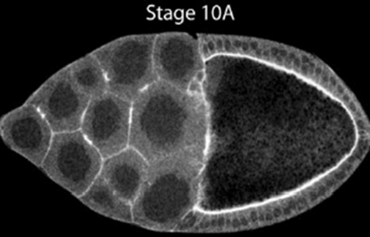
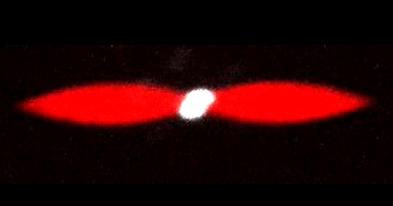
Order and fluctuations in biological soft matter
Kinjal Dasbiswas
Department of Physics
University of California, Merced where: ACS 266, what: Soft Matter and Biological Physics (Cell Mechanics, Active Matter)
Cell materials
Cell culture
Tissue

Slide 2
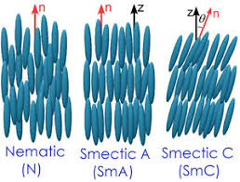
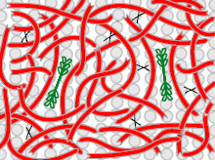
Soft condensed matter and biological physics
“Soft”: easily deformable/excitable (by thermal energy ~ k_{B}T)
Amorphous with ``large’’ scale structure (10 nm –μm) (contrast with crystal lattice or molecular liquid)
Entropy ~ Interactions -> multitude of phases, self-assembled structures
Thermal >> Quantum fluctuations
In numbers, elastic modulus:
Polymer network (Gel)
Liquid crystal phases
Bacterial swarming in fluid (active matter)
Biology: Stiffness of a cell: (Kollmansberger & Fabry, 2011)
Life requires flexibility: assembly, disassembly - weak interactions
Notes:
1 eV = 40 kT, semiconductor bndgap 1 eV, nuclear

Slide 3
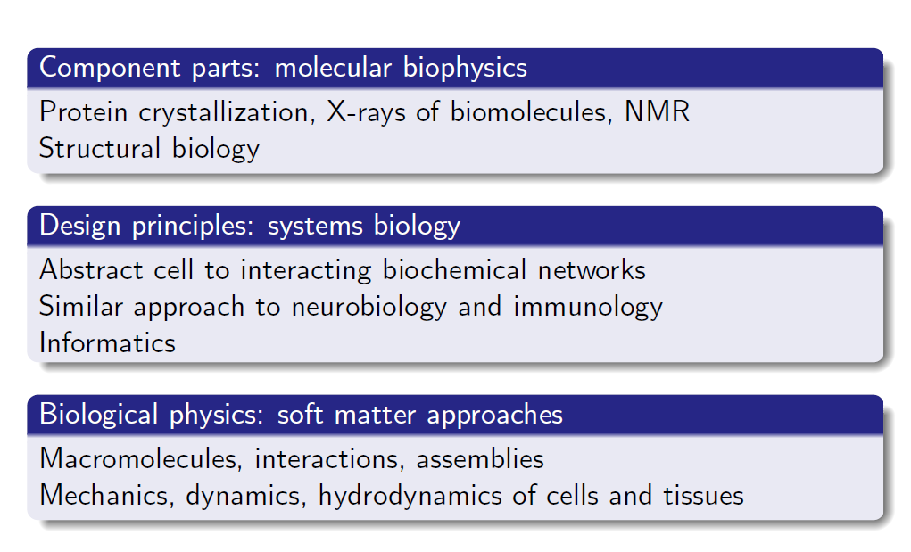
So what is “biophysics”?
It is what people who call themselves “biophysicists” do….
Notes:
1 eV = 40 kT, semiconductor bndgap 1 eV, nuclear

Slide 4
Why we work on soft matter and biological physics?
Condensed matter historically began as “solid state” physics, studying materials important for the semiconductor industry (and other applications). Biological physics has applications, but is driven by intellectual curiosity as well.

Slide 5
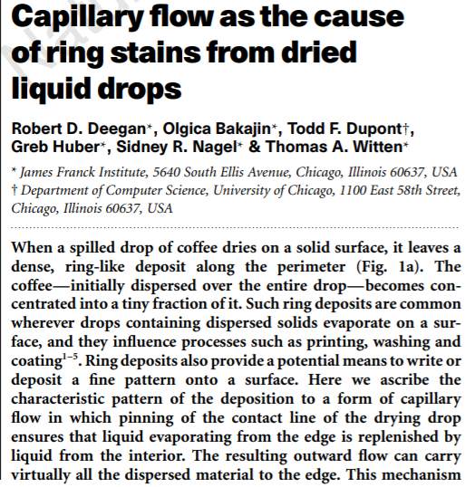
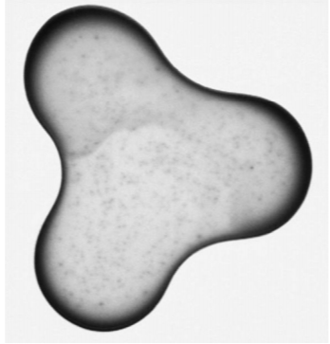
Just one thing I like about soft matter and biological physics
As I glance out my window in the early morning, I can see beads of droplets gracing a spider web. The film of beads that has settled on the thread is unstable and breaks up into droplets...I take my morning shower. The moment I step out, I dry off by way of evaporation and dewetting... As I rush into my car under a pelting rain, my attention is caught by small drops stuck on my windshield... - P.-G. de Gennes (Nobel Prize in Physics, 1991); F. Brochard-Wyart; D. Quéré in Capillarity and wetting phenomena;

Slide 6
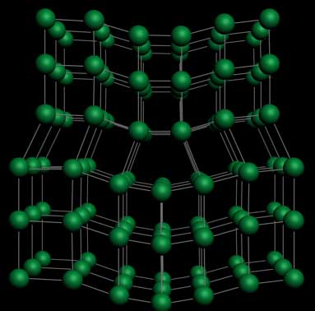
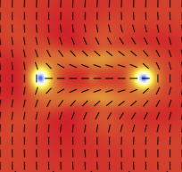
Order, fluctuations and defects: biological matter is condensed matter
Condensed Matter Physics: general framework for describing "condensed" phases that appear whenever the number of constituents in a system is extremely large and the interactions between the constituents are strong.
Biology: A cell has many component parts (biomolecules: DNA, proteins, lipids..) that interact and self-assemble into mesoscale structures. Important difference from “dead matter”: non-equilibrium, evolution!
Ordered phases: thermal and “active” noise induce defects, influence material properties
Dislocation in crystal
Disclination in liquid crystal
Notes:
Nasa definition of life: self-replicating chemical reactions that follow Darwinian evolution

Slide 7
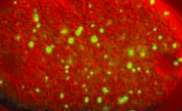
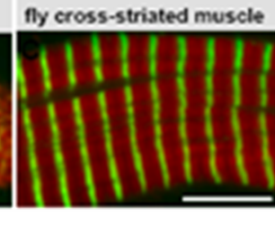
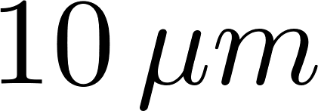
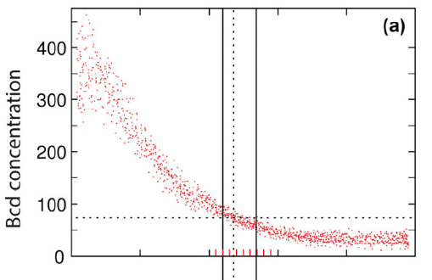
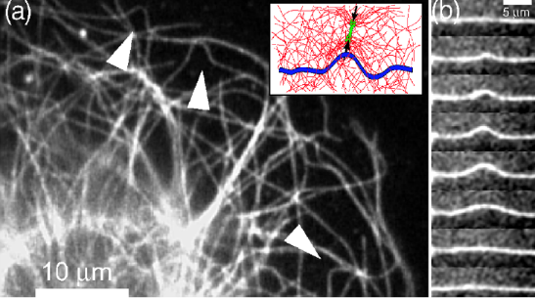
Order and fluctuations in cells
Structural order in muscle: (Many molecular actors but active mechanical forces important for order)
Protein droplet phase separation (like “oil-water”)
Order parameter: Competition of ordering force with noise leads to phase dynamics
Biology is noisy in several ways:
${10}^{6}≪{10}^{23}$!
Active bending fluctuations of a microtubule caused by molecular motors Brangwynne et al. PRL 08
Variability in protein concentration Gregor et al. Cell ‘07
Notes:
Red-Green phase separation like spin up-down domains in Ising model

Slide 8
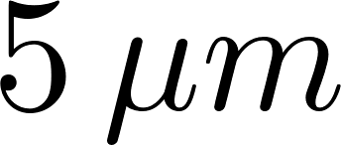
Self-organization of molecular motors: two disparate examples in our research
Structure:
Hu, Dasbiswas,……, Bershadsky, Nat. Cell Bio ‘17
Weirich, Dasbiswas…,Gardel, PNAS ‘19
Single cell in culture | Cellular proteins in vitro
Cytoskeleton with stable fibers (elastic gel) | Cytoskeletal filaments, linkers and motors (fluid gel)
Notes:
Stop this from playing repeatedly

Slide 9
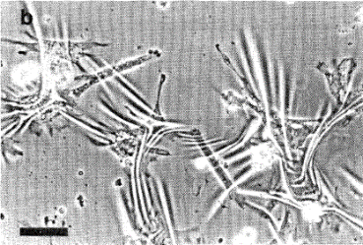
Cell mechanics in development
Cell contractility as elastic dipole
Mechanical forces affect cell structure and function
Discher group: Engler et al. Cell 2006
Cells on a rubber substrate
Harris et al. (‘80)
Cells exert forces on and sense their mechanical environment. Forces important for a variety of functions: muscle cell contraction, cell division, cell shape changes during tissue development, cell motility.
Structural order in cells and tissue influenced by mechanics
Cells interact mechanically through mutual deformations of elastic medium

Slide 10
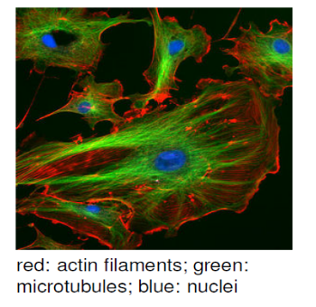
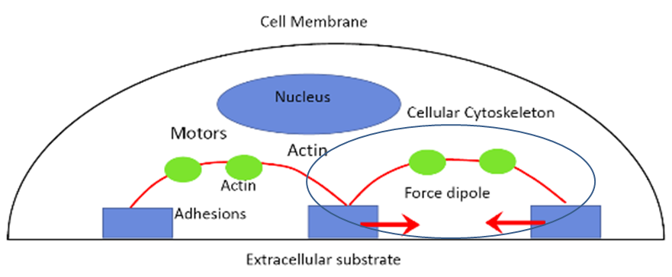
Filaments and motors: the cell force generation machinery
Cell cytoskeleton
Schematic adherent cell
Cytoskeleton: transport, structure, force-generation
Active mechanical forces in the cell cytoskeleton
Myosin activity (ATP consumption)
membrane
Actin filaments polymerize and depolymerize (ATP consumption)

Slide 11
Underlying structure of muscle contractile unit

Slide 12
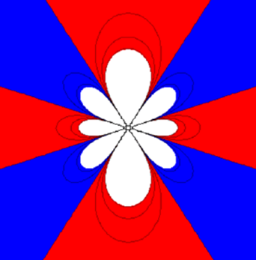
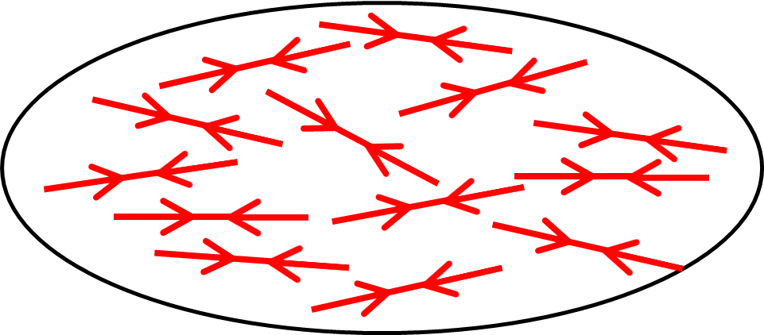
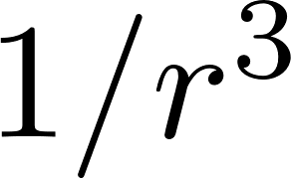
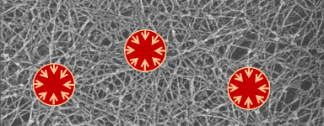
Cell mechanics in development
Cell contractility as elastic dipole
Theory of cell elastic interactions
Deformation by single force dipole
Cytoskeleton as a collection of polarizable active elastic dipoles
Deformation (strain) field of elastic dipole :
distance dependence ~ electric dipole orientational dependence ~ electric quadrupole
Red: expansion, Blue: compression
Ref. Rev. Mod. Phys. ’13, Schwarz & Safran
Interaction of cells mediated by substrate Dipolar stress field of one cell interacts with the strain field induced by another:
Notes:
Single cell vs multiple cells (color coding)

Slide 13
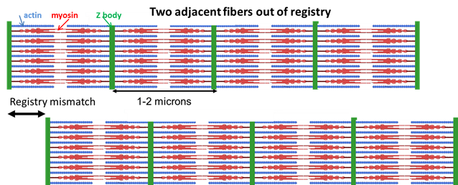
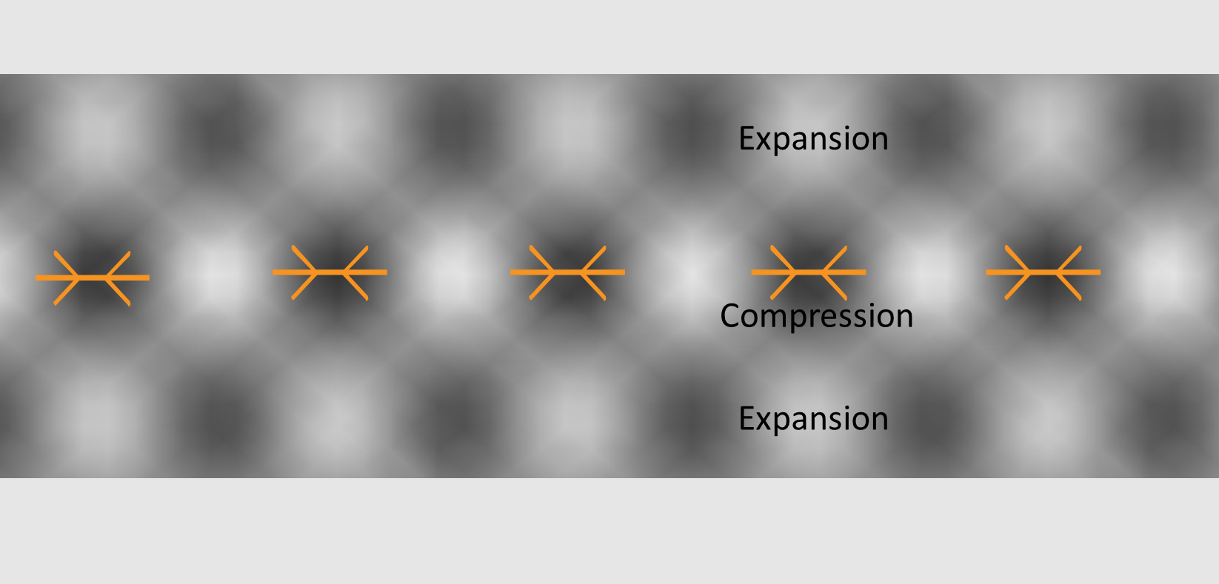
Structural registry of fibrils in muscle can arise from substrate-mediated elastic interactions
Each fibril a periodic structure of actin and myosin
Registry across separate fibrils (not in contact) gives rise to striations in muscle
Experiment: Extent of registry (striation) depends on substrate mechanical rigidity
Theory of elastic dipole interactions explains order
Notes:
Needs a cartoon for cell-on-gel experiment and measurement of strain

Slide 14
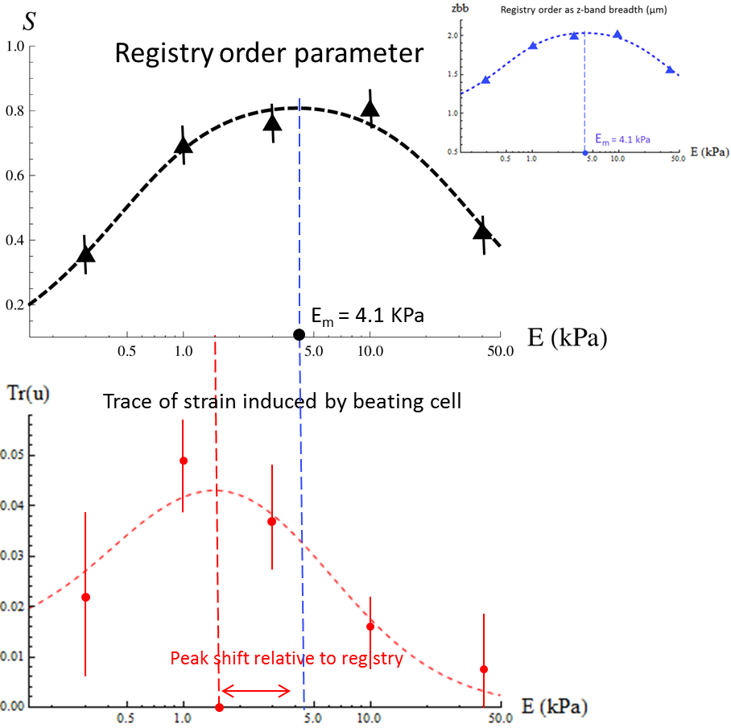
Measurements and theory of the beating strain (function) and registry (structure) of cardiomyocytes
Force balance leads to elastic interactions between neighboring fibrils
Statistical physics model: competition between ordering elastic interactions and disordering noise
Ansatz to connect structure and dynamical function: registered bundles of fibrils beat in phase
Experimental dependence of registry and strain on substrate stiffness
Dasbiswas, Majkut, Discher, Safran, Nat. Comm. 2015
Notes:
Summary slide; bullet points (reduce text and animate); short sentences -> combine first two; “assumption” (mechanical synch.)

Slide 15
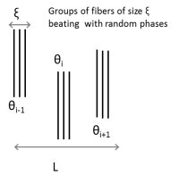
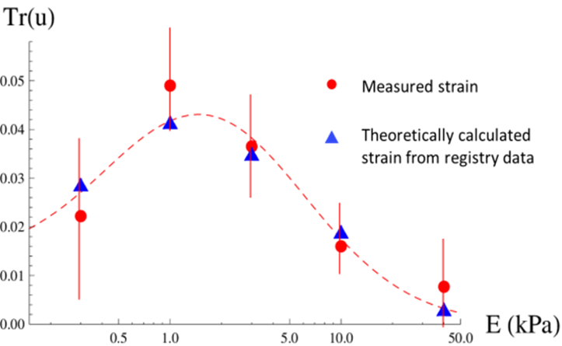
Model relates beating strain to registry in a heart muscle cell
Statistical physics model predicts average substrate strain around the cell, Tr(u), as a function of the experimentally measured registry correlations S :
Beating strength:
Strains calculated from the registry data by
our model match measured strains!
No fitting parameters
Dasbiswas, Majkut, Discher, Safran, Nat. Comm. 2015
Notes:
estimate magnitude of strain from number of motors); say “S” again;

Slide 16
Simple physical understanding of complex systems
Our approach: Physics first, techniques later…….
Anyone who wants to analyze the properties of matter in a real problem might
want to start by writing down the fundamental equations and then try to solve
them mathematically. Although there are people who try to use such an
approach, these people are the failures in this field; the real successes come to
those who start from a physical point of view, people who have a rough idea
where they are going and then begin by making the right kind of
approximations, knowing what is big and what is small in a given complicated
situation. These problems are so complicated that even an elementary
understanding, although inaccurate and incomplete, is worthwhile having, and
so the subject will be one that we shall go over again and again, each time with
more and more accuracy, as we go through our course in physics. - Richard Feynman (obligatory Feynman quote)
Notes:
estimate magnitude of strain from number of motors); say “S” again;

Slide 17
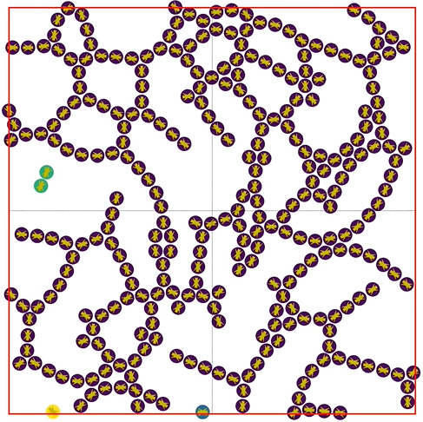
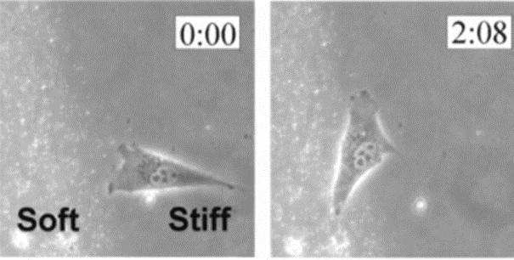
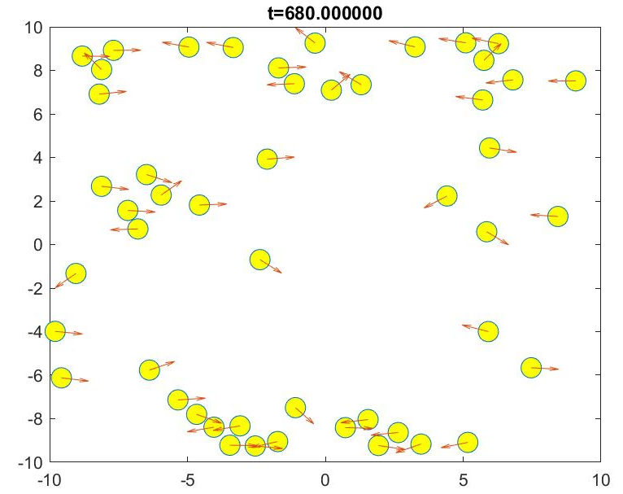
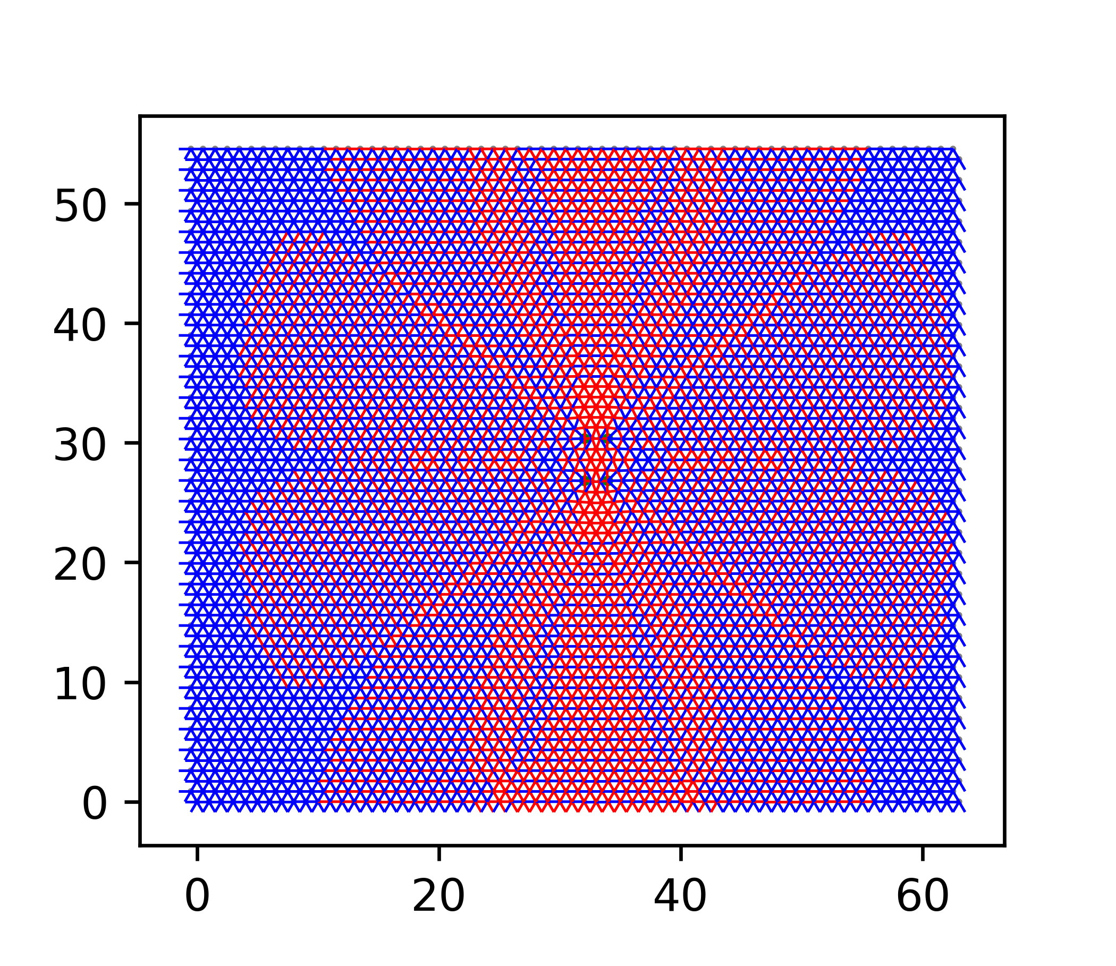
So what are we up to now?
Modeling networks with cell dipoles (Patrick Noerr)
Modeling cell motility near interfaces (Subhaya Bose)
Cells align parallel or perpendicular to the interface between stiff and soft substrates (Dembo lab)
Vascular network structure of endothelial cells cultured on a soft substrate depends on stiffness (Reinhart-King lab)
Model simulations of cellular force dipoles interacting through substrate deformations leads to chains and loops of cells. (with Gopinathan lab)
Model motile cell dipoles align parallel to top and bottom boundaries because of elastic torques exerted at interface
Modeling mechanical force transmission in the cytoskeleton (Abhinav Kumar)
(with Gopinath lab)
Force dipole in a fiber (spring) network
Elastic interactions between dipoles modeling myosin motors through the fiber network modeling the cytoskeleton
Notes:
estimate magnitude of strain from number of motors); say “S” again;

Slide 18
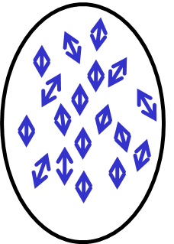
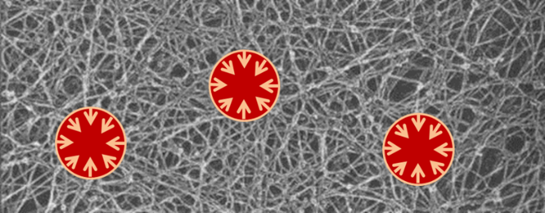
Theory methods: Continuum Mechanics
Elasticity theory in a nutshell:
Theory of Elasticity, Landau & Lifshitz
Force balance: “+” “constitutive relations” (e.g. stress proportional to strain in linear response) “+” boundary conditions
In linear and isotropic elastic medium, displacement is :
should remind you of Poisson’s equation from Electrostatics!
Force density exerted by a distribution of force dipoles (model for cell forces)
How cells and intracellular motors organize themselves through elastic interactions?
“Minidipoles” within a cell
Cells on fibrous matrix
Mechanical medium: discrete, nonlinear, viscoelastic

Slide 19
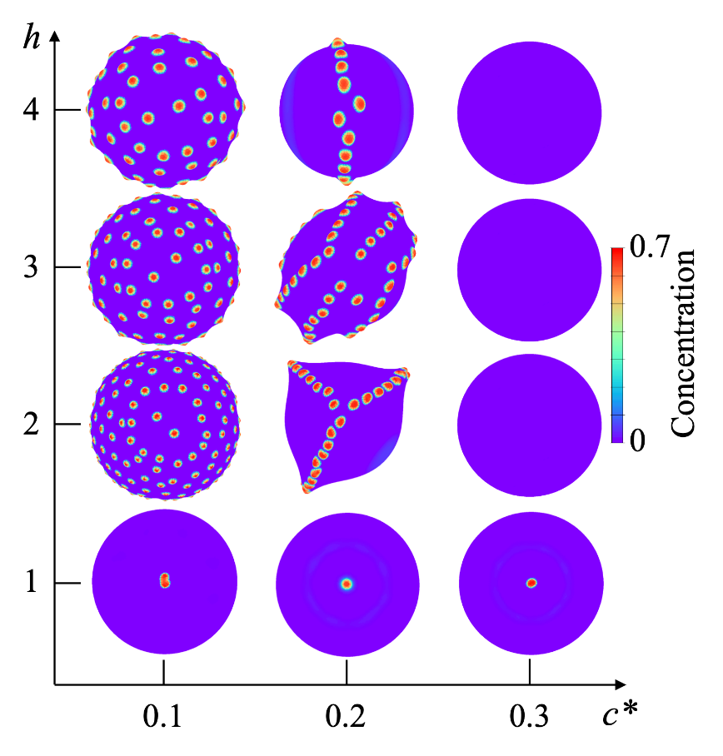
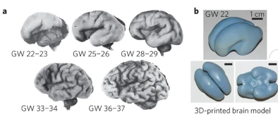
Tissue Morphogenesis-inspired mechanochemical wrinkling
Chemicals can activate cell forces + thin sheets deform easily when compressed (buckling)
“Spots” vs. “Ridges” on a spherical shell
Shell thickness
Chemical “Actuation” Threshold
Model and finite element simulations by Andrei Zakharov, postdoc UC Merced

Slide 20
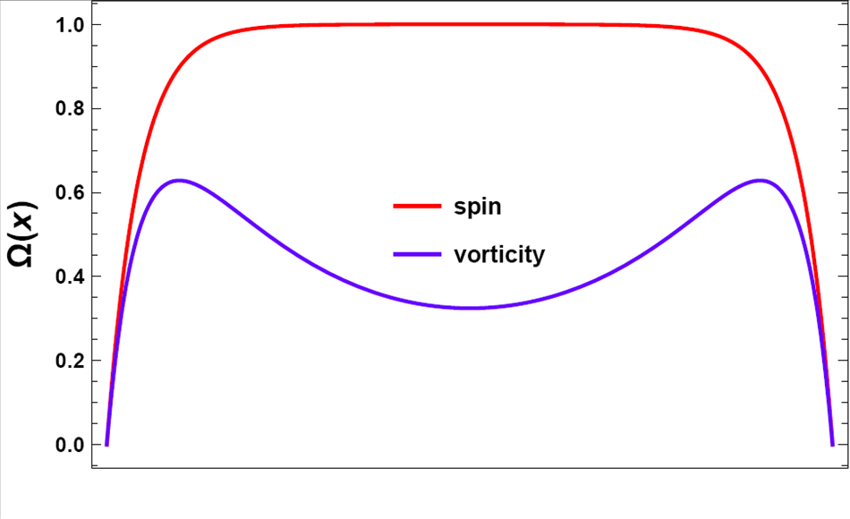
Theory methods: Hydrodynamics and statistical physics
Chiral active matter
Torque balance:
Force balance:
Tsai et al., PRL ’05, Fürthauer et al., EPJE ’12, etc…. Van Zuiden et al. PNAS ‘16
General principles:
Symmetry, conservation, order
(See Chaikin and Lubensky, Principles of Condensed Matter Physics)
Example, Toner-Tu eq. for flocking:
(See Rev. Mod. Phys. ‘13 by Marchetti et al.)
Steady state edge flows result from theory
We found an analogy with topological insulators (see Dasbiswas et al., PNAS ‘18)

Slide 21
Active droplets show patterns and shape changes (recall dividing droplet “artificial cell” experiment)
Model and numeric simulations by Fabian Jan Schwarzendahl (postdoc, UC Merced)

Slide 22
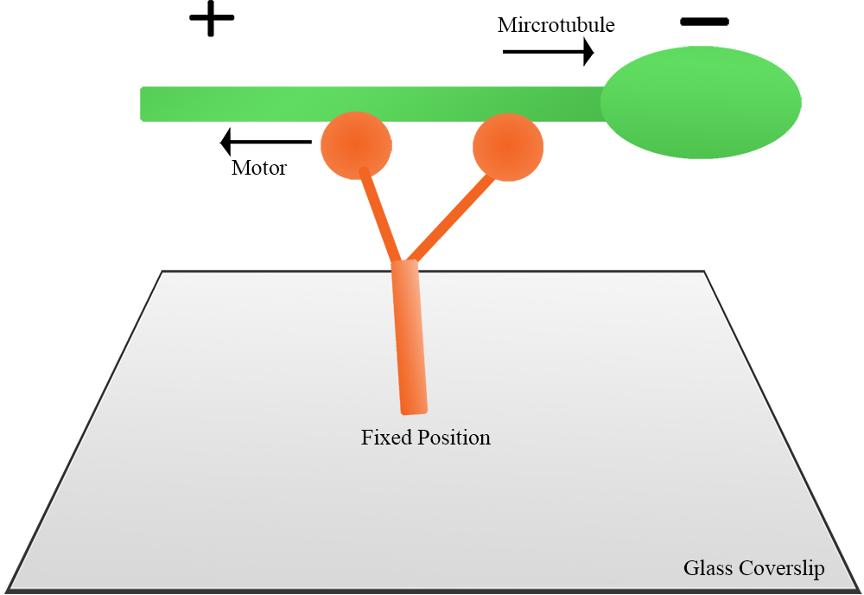
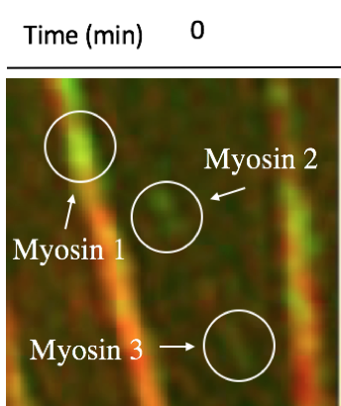
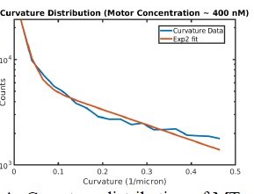
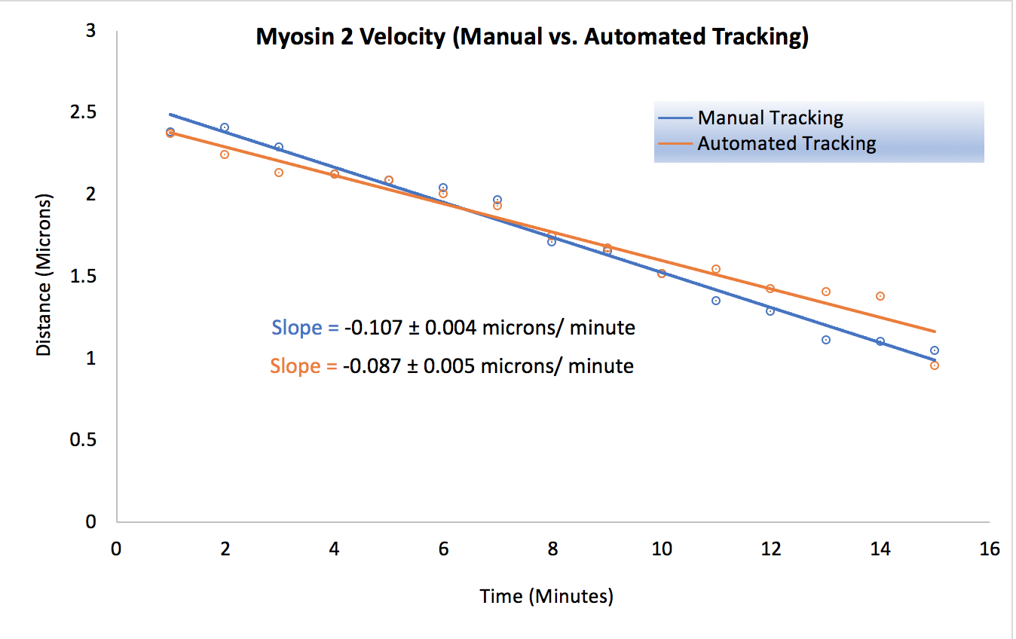
Close collaboration with experiments
Statistics of bending filaments (with Jing Xu lab)
Myosin movements in the cell. Tracked by Gargee Khaparde (summer UG student) Bershadsky lab (NUS Singapore)
Madhuvanthi Athani (spring 2019 rotation)

Slide 23
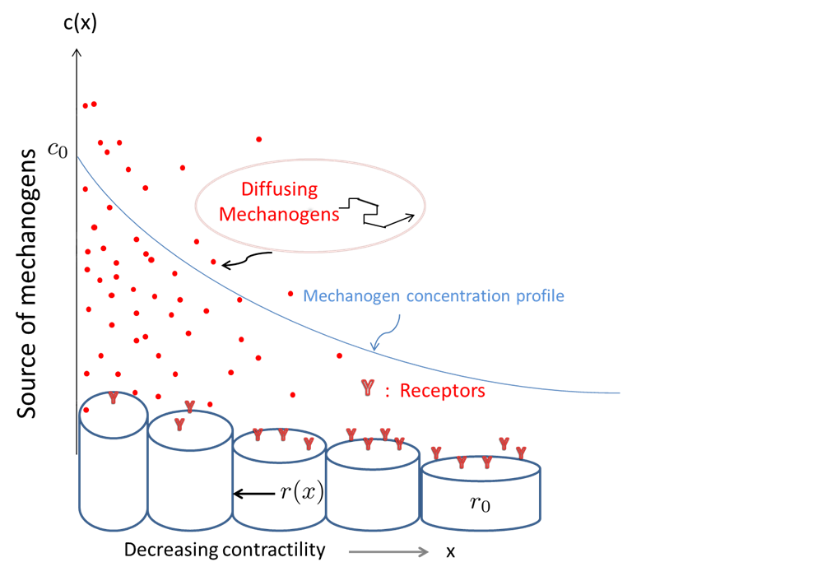
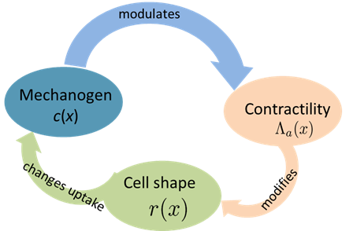
Biological physics: Cell biology can stimulate statistical and soft matter physics
Feedback and cycles through mechanochemical couplings
Long-range interactions (screening)
“Complex systems”:
H. Zhang , KD,…., D.V. Talapin (Nature ‘17)
N.B.Ludwig, KD…... (JCP ‘18.)
Active components
Strong fluctuations
Strong interactions
Emergent structures
KD et al (Biophy. J. ‘18)
Geometry and Topology in flows of matter and information (with S. Vaikuntanathan, A. Souslov, V. Vitelli)
Topological modes in active fluids
Stochastic
Quantum
KD et al. PNAS 2018; A. Souslov, KD…...Vitelli (PRL ‘19)
Notes:
lead to chalk talk: put acknowledgment and this slide into chalk talk organize the names

Slide 24
Collaborations and Acknowledgments
Current group: 1.postdocs shared with Daniel Beller Andrei Zakharov: mechanochemical feedback in cell sheet folding inspired by tissue morphogenesis Fabian Schwarzendahl: active matter hydrodynamic model for motor + filament systems (hydrodynamics) 3. Graduate students: Patrick Noerr, Abhinav Kumar, Subhaya Bose
Experimental collaborators:
Dennis E. Discher, UPenn
Alexander D. Bershadsky, Weizmann & NU Singapore
Margaret L. Gardel, UChicago
Kimberly Weirich, Clemson
Linda Hirst, UC Merced
Kara McCloskey, UC Merced (MBSE) Theory collaborators
Samuel Safran, Weizmann Institute
Thomas Witten, UChicago
Suri Vaikuntanathan, Uchicago
Ajay Gopinathan, UC Merced
Arvind Gopinath, UC Merced (BioE)
Notes:
Slide numbers; get a laser pointer; concluding slide stronger; too many first slides; lead into chalk talk

